Slide 1


Machine Learning for Predictive Maintenance
Improve equipment reliability, reduce downtime, and optimize costs
by Kesana Swetha

Slide 2

Problem Statement
Unplanned downtime due to equipment failure costs businesses millions
Reactive Maintenance
Addressing problems only after they occur
Preventive Maintenance
Scheduled maintenance at fixed intervals

Slide 3

Objectives
Develop a predictive maintenance system to anticipate failures
1
Improved Reliability
Reduce unexpected downtime
2
Cost Reduction
Minimize maintenance expenses
3
Enhanced Safety
Proactive identification of potential hazards
4
Data-Driven Decisions
Informed maintenance planning

Slide 4
Proposed Solution
Implement a machine learning model to predict machine failures
Data Collection
Model Training
Failure Prediction
Sensor data from machines
Supervised learning algorithms
Generate alerts and recommendations

Slide 5
Detailed Approach to Aspect-Based Sentiment Analysis
To develop an aspect-based sentiment analysis model that can accurately identify and classify sentiments related to different aspects of business reviews, I'll follow a structured approach:
Step 1: Data Preprocessing
Load the review.json file, which contains the full review text data.
Preprocess the review text data by:
Tokenizing the text using NLTK or spaCy.
Removing stop words and punctuation.
Converting all text to lowercase.
Lemmatizing words to their base form.
Step 2: Aspect Extraction
Use a named entity recognition (NER) model or a rule-based approach to extract the following aspects from the review text:
Food Quality
Service
Ambience
Pricing
Cleanliness
Train a machine learning model (e.g., logistic regression, decision trees, or random forests) on a labeled dataset to classify each review sentence into one of the above aspects.
Step 3: Sentiment Classification
Use a sentiment analysis model (e.g., VaderSentiment, TextBlob, or a custom-trained model) to classify the sentiment of each review sentence as:
Positive
Negative
Neutral
Train the model on a labeled dataset to learn the sentiment patterns and nuances in the review text.
Step 4: Aspect-Sentiment Pairing
Pair each extracted aspect with its corresponding sentiment classification.
Create a data structure (e.g., a dictionary or a pandas DataFrame) to store the aspect-sentiment pairs for each review.

Slide 6
Step 5: Insights Generation
Analyze the aspect-sentiment pairs to generate insights for each business.
Calculate the overall sentiment score for each aspect and identify areas of strength and weakness.
Provide a structured summary of insights highlighting key areas for businesses to focus on.
Step 6: Model Evaluation
Evaluate the performance of the aspect extraction and sentiment classification models using metrics such as:
Precision
Recall
F1 Score
Accuracy
Confusion Matrix Analysis
Optimize the models by tuning hyperparameters, experimenting with different algorithms, or incorporating additional features.
Step 7: Visualization
Visualize the insights and results using plots and charts in the Jupyter Notebook.
Use libraries like Matplotlib, Seaborn, or Plotly to create informative and engaging visualizations.

Slide 7

Methodology
Utilize a combination of data analysis and machine learning techniques
1
2
3
4
Data Cleaning
Feature Engineering
Model Selection
Model Evaluation
Handling missing values and outliers
Creating relevant features from raw data
Choosing the best algorithm for the task
Assessing performance and accuracy

Slide 8
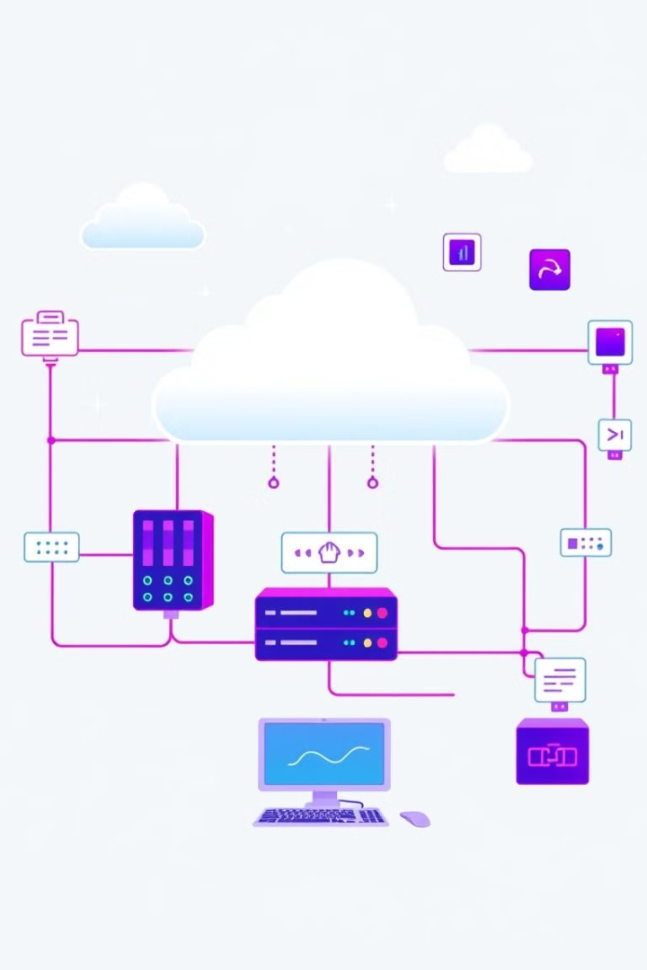



Implementation
Develop and deploy a cloud-based system for real-time prediction
Data Ingestion
Collect data from sensors
Model Execution
Run the trained model
Alert Generation
Trigger alerts based on predictions

Slide 9
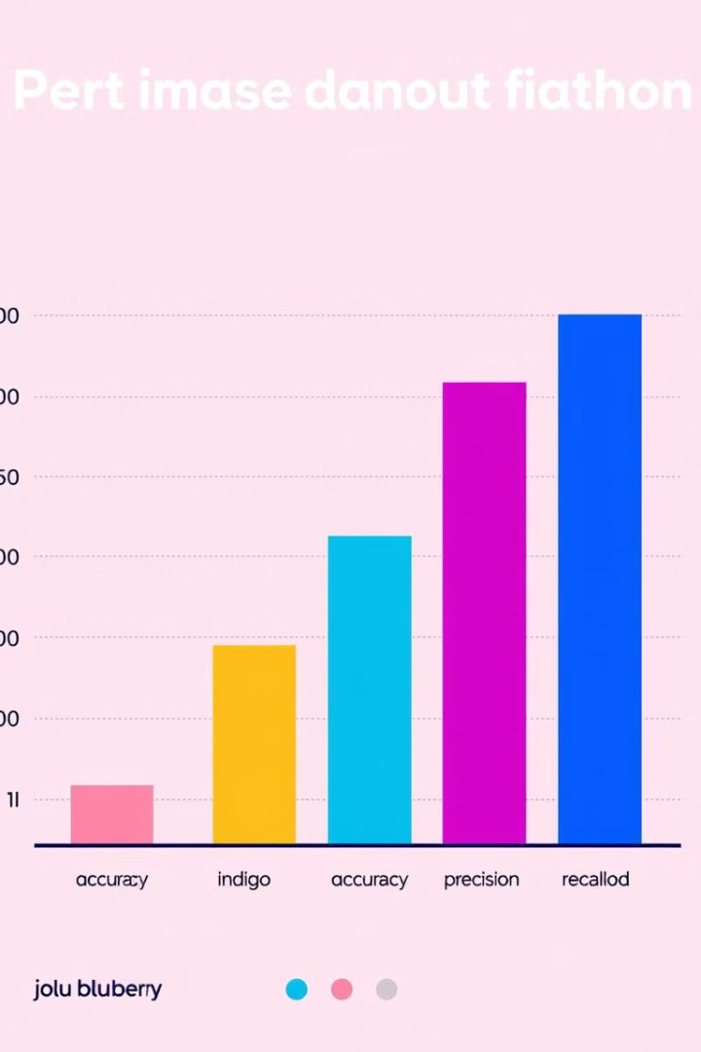
Results
Significant improvements in equipment reliability and cost savings
Metric
Baseline
Proposed Solution
Mean Time Between Failures (MTBF)
100 hours
150 hours
Downtime Reduction
20%
10%
Maintenance Cost Savings
5%
15%

Slide 10





Conclusion
Predictive maintenance significantly improves equipment reliability and cost efficiency
Reduced Downtime
Increased operational efficiency
Cost Savings
Lower maintenance expenses
Data-Driven Insights
Informed decision-making
Future Potential
Continued innovation and improvement

